Slide 1
The Application Layer
Chapter 7

Slide 2
DNS – The Domain Name System
The DNS name space
Domain Resource records
Name servers

Slide 3
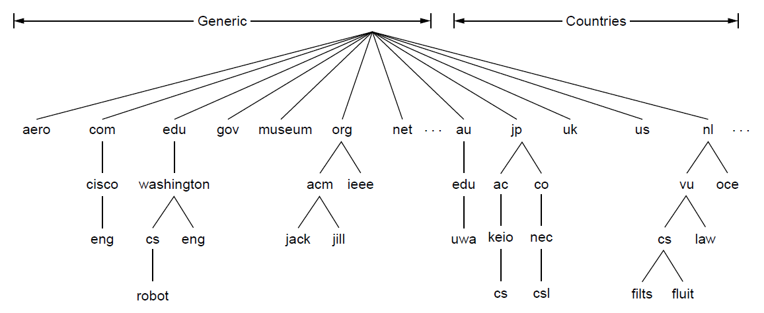
The DNS Name Space (1)
A portion of the Internet domain name space.

Slide 4
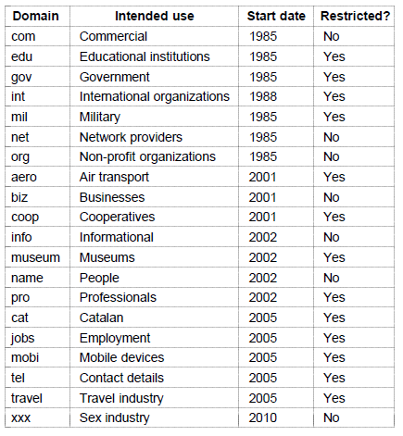
The DNS Name Space (2)
Generic top-level domains

Slide 5
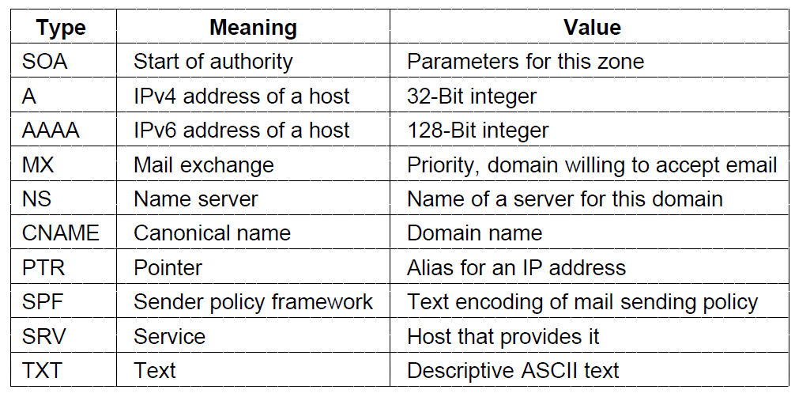
Domain Resource Records (1)
The principal DNS resource record types

Slide 6
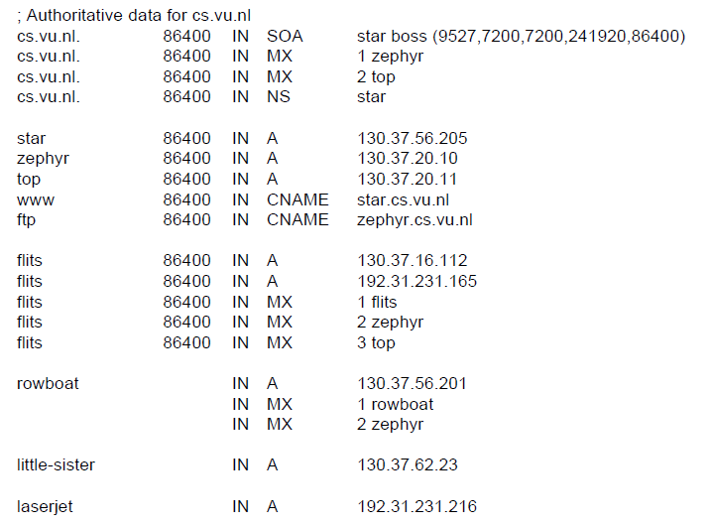
Domain Resource Records (2)
A portion of a possible DNS database for cs.vu.nl.

Slide 7
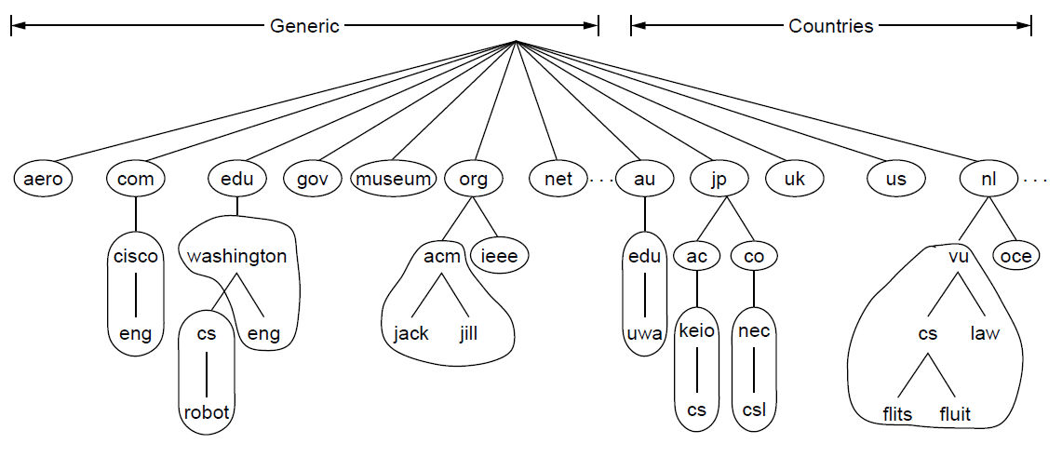
Name Servers (1)
Part of the DNS name space divided into zones
(which are circled).

Slide 8
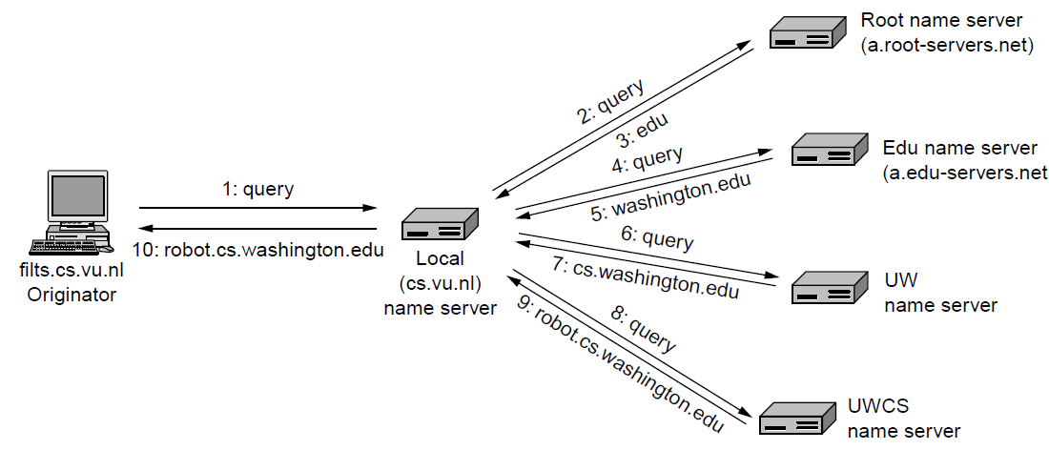
Name Servers (2)
Example of a resolver looking up a remote name in 10 steps.

Slide 9
Electronic Mail
Architecture and services
The user agent
Message formats
Message transfer
Final delivery

Slide 10
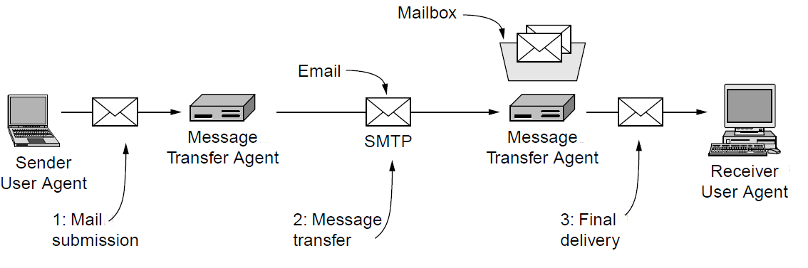
Architecture and Services (1)
Architecture of the email system

Slide 11
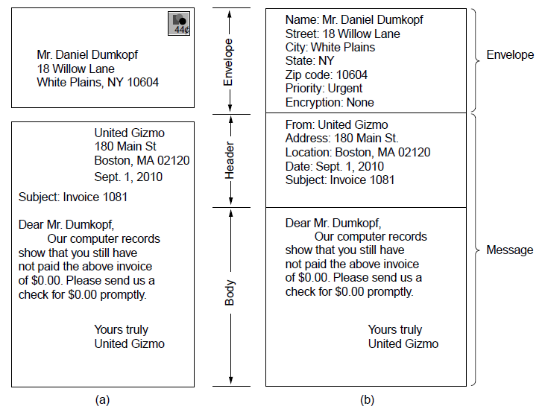
Architecture and Services (2)
Envelopes and messages. (a) Paper mail. (b) Electronic mail.

Slide 12
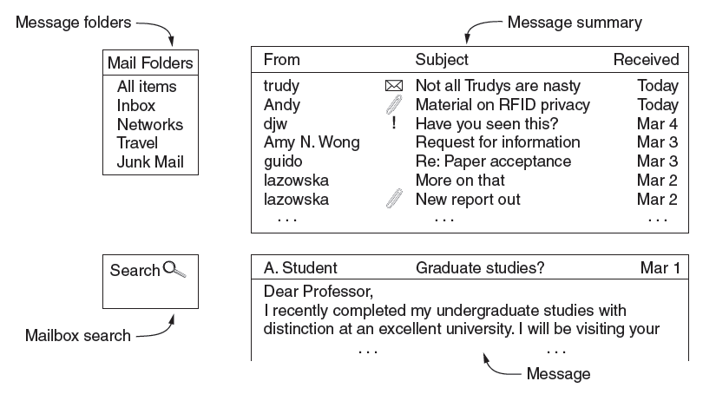
The User Agent
Typical elements of the user agent interface

Slide 13
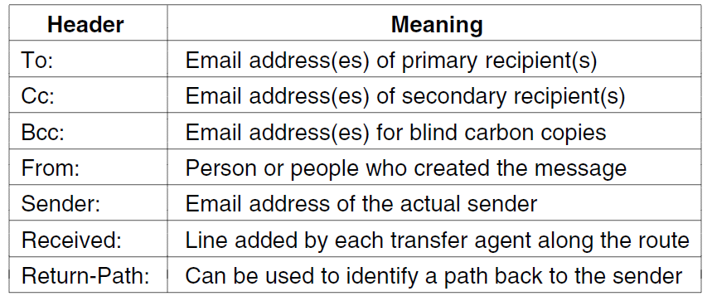
Message Formats (1)
RFC 5322 header fields related to message transport.

Slide 14
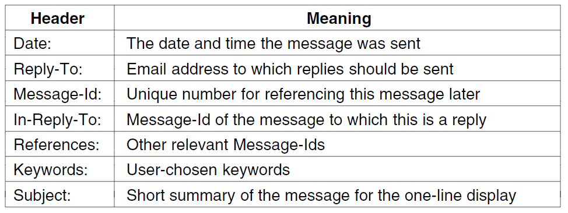
Message Formats (2)
Some fields used in the RFC 5322 message header.

Slide 15
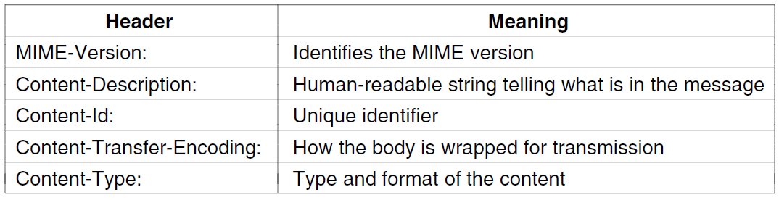
Message Formats (3)
Message headers added by MIME.

Slide 16
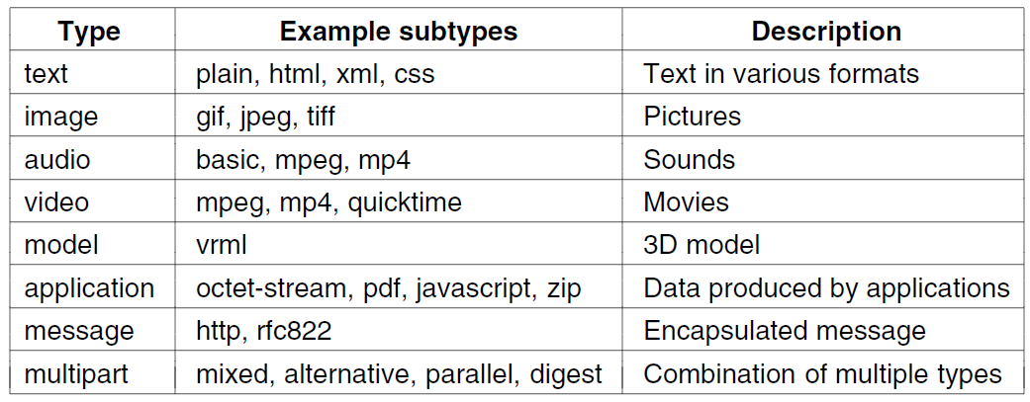
Message Formats (4)
MIME content types and example subtypes.

Slide 17
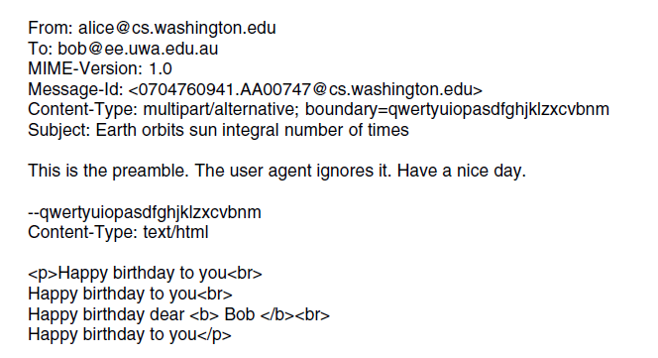
Message Transfer (1)
. . .
A multipart message containing HTML and audio alternatives.

Slide 18
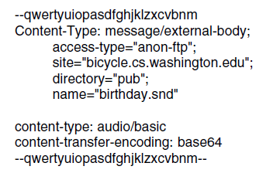
Message Transfer (2)
. . .
A multipart message containing HTML and audio alternatives.

Slide 19
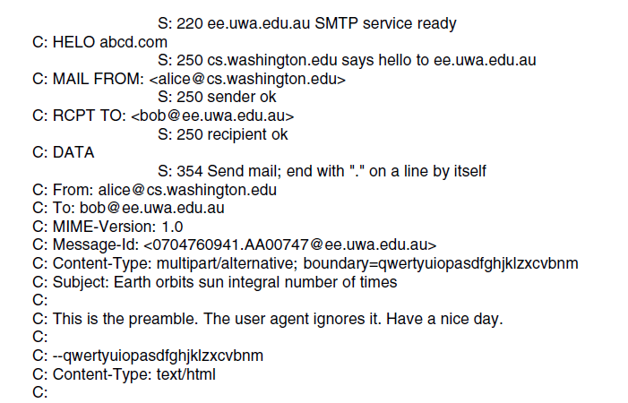
Message Transfer (3)
. . .
Sending a message from alice@cs.washington.edu to bob@ee.uwa.edu.au.

Slide 20
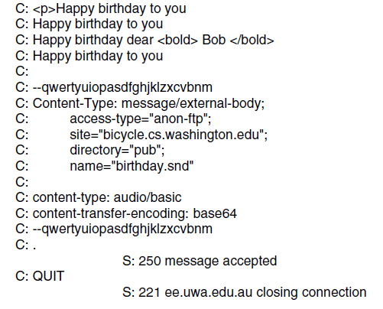
Message Transfer (4)
. . .
Sending a message from alice@cs.washington.edu to bob@ee.uwa.edu.au.

Slide 21
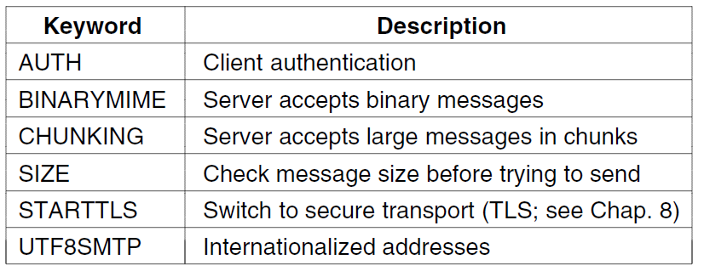
Message Transfer (5)
Some SMTP extensions.

Slide 22
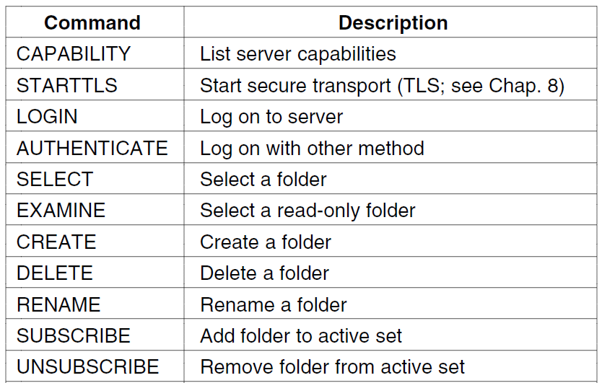
Final Delivery (1)
. . .
IMAP (version 4) commands.

Slide 23
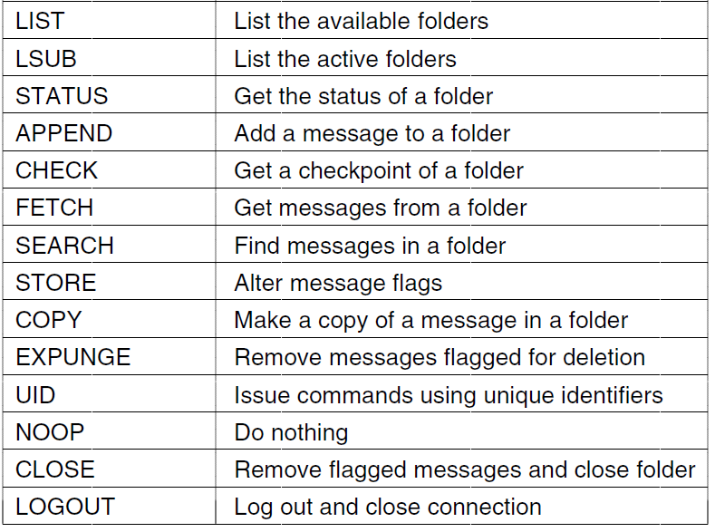
Final Delivery (2)
. . .
IMAP (version 4) commands.

Slide 24
End
Chapter 7

